Slide 1

Our Beautiful
Stinky Friends
A Practical Guide
to Fermentation

Slide 2
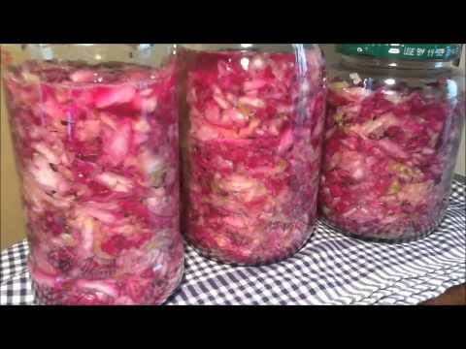
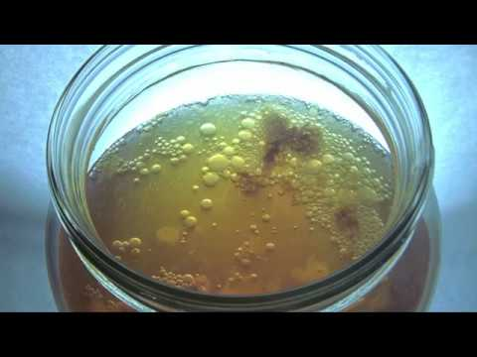
Fermentation is “Cooking”
These Substances!
Fermentation is a means of cooking food without heat. It is done by microbes but can be controlled by humans to produce foods with unique tastes. Humans have used fermentations to present food for millenia!

Slide 3
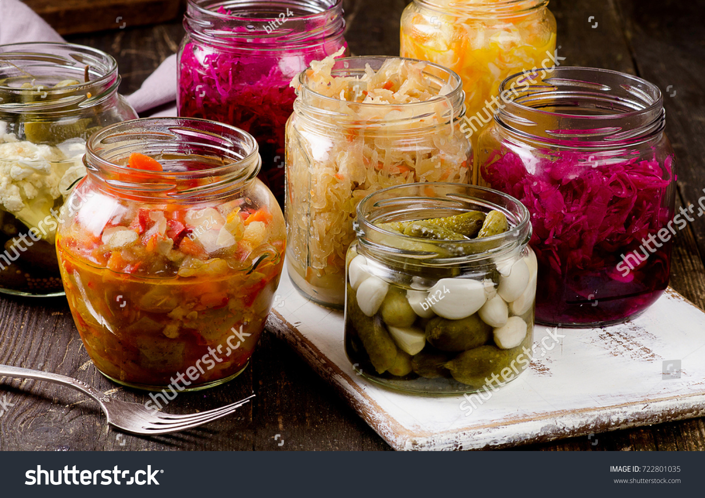
What is Fermentation?
Describes one way that organisms make energy when oxygen levels are low in cells
Occurs in all biological organisms
Makes energy to sustain but happens at a cost
Produces by-products that make the organism has to remove or break down
This process can be manipulated in microbes to make many different types of food
Image credit: Shutterstock

Slide 4
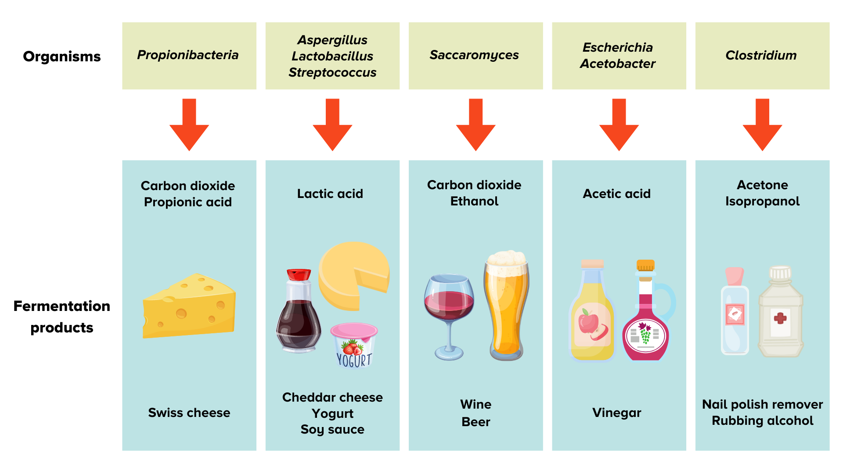
What Can We Make by Fermentation?
The table to the right shows five microbes and the types of food products that make when they are fermented.
Which is your favorite? Note: You must be at least 21 years of age to select the center picture.
Illustration by Sandy Roberts for Science Friday. Graphics from Canva.

Slide 5
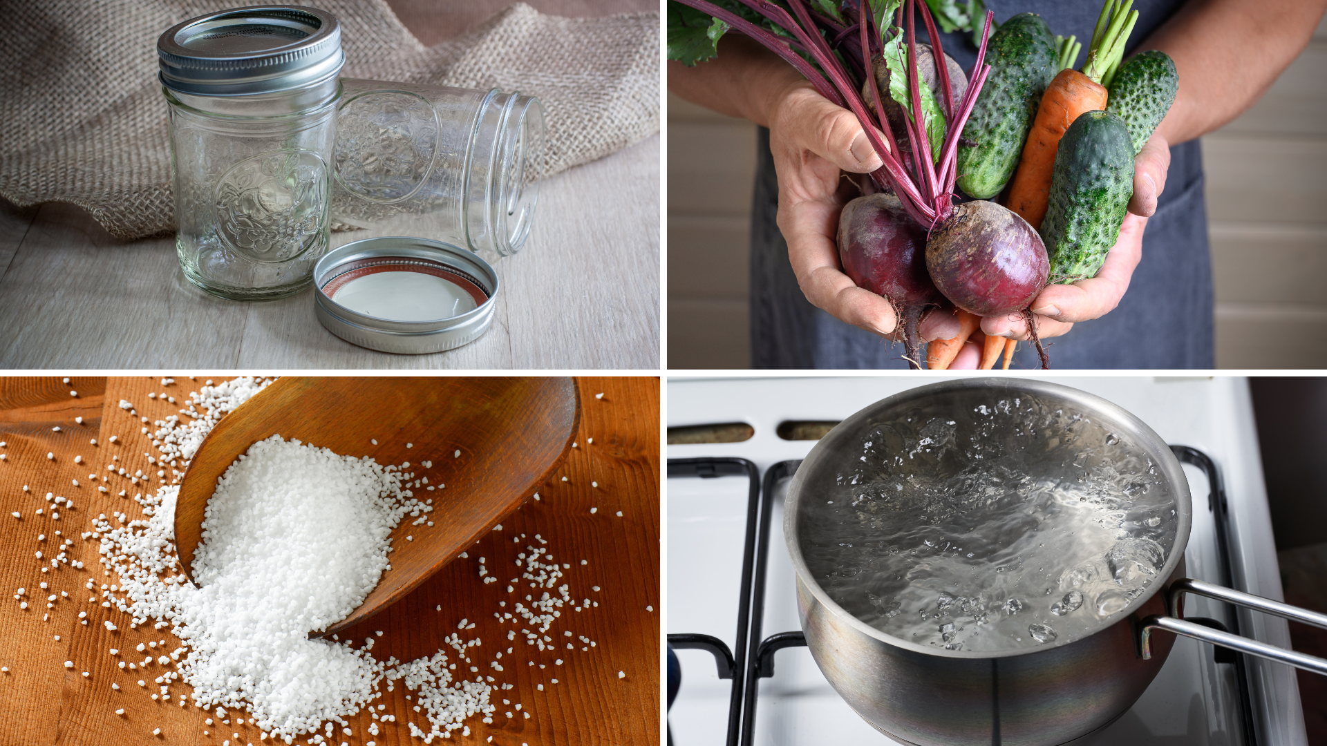
What Materials Do I Need to Ferment?
Required:
A sterile jar with lid
A firm vegetable
Kosher or sea salt
A way to sterilize the jars
Knife and cutting board
Optional:
Dried spices such as thyme, sage, rosemary, dill, or caraway seeds
Garlic and/or onions
Illustration by Sandy Roberts for Science Friday. Graphics from Canva.

