Slide 1
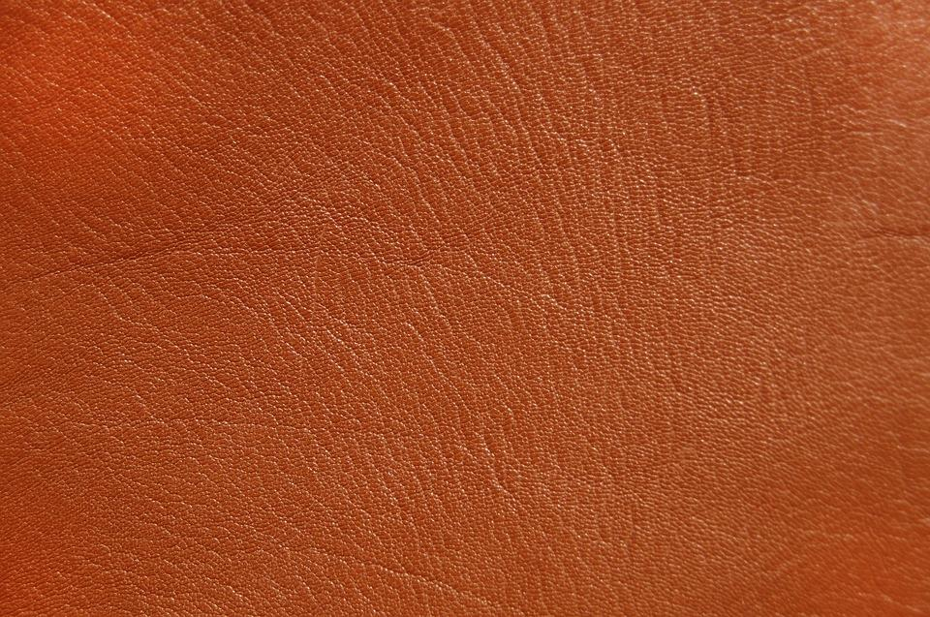
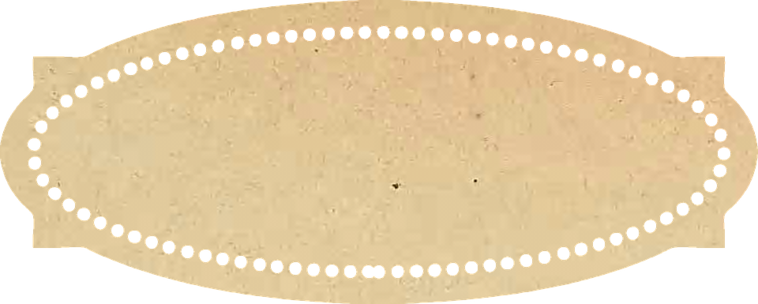

Paleontology
Field Journal
Resource by Nick VanAcker
Notes:
https://pixabay.com/photos/leather-background-structure-orange-2719497/

Slide 2
Use your Paleontology Field Journal to answer questions,
make observations, and sketch specimens. Remember, just like real paleontologists, your hypothesis and experiment will be based on evidence - so be sure to take good notes! Note pages for writing and drawing are available at the back of this handout.
The Fossil Record
Before any hypotheses are made about how sauropods digested their food, we first need to look at some hard evidence. This evidence is hard, literally. It’s fossilized rock!
Examine Sauropod Teeth
To develop a sauropod digestive tract, we first have to figure out what the sauropod is digesting! The best way to do that with fossils is by examining the teeth. Paleontologists are lucky here - teeth are one part of the body that fossilize quickly. While there are around 30 species of sauropod, there are two main styles of teeth that are common across the whole group.

Slide 3
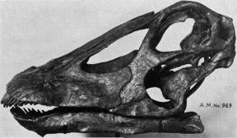
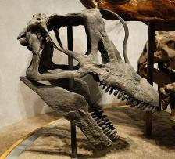
Look at the shape of the teeth in the diagrams below.
Diagram A shows one shape and Diagram B shows the other.
A
B
Galeamopus hayi, a species of diplodocus
Brachiosaurus Skull
How would you describe the shape of the two tooth types?
A__________________________________________________________________________________________________________________________________________________________________________________________________________________________
B__________________________________________________________________________________________________________________________________________________________________________________________________________________________
Based on the shapes, predict a sauropod diet. Do you think these sauropods ate mostly leaves, nuts, meat, or something else? Why?
____________________________________________________________________________________________________________________________________________________________________________________________________________________________

Slide 4
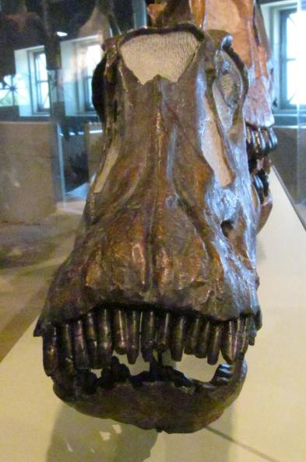
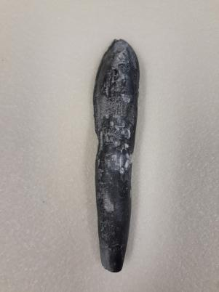
Paleontologists call Tooth Type A “peg-like”, and Tooth Type B “spatulate” or “spoon-like”. Both types are highly specialized–they’re built for a very specific purpose.
Type A - Peg-like Teeth
Type B - Spoon-like Teeth

Slide 5
Examine the sauropod tooth diagrams again, and fill in the table below.
 | Peg-like Teeth | Spoon-like Teeth
What does each style of tooth remind you of?
What do you think each tooth shape would be good for?
What do you think each tooth shape would not do well?
How do you think sauropods used these teeth to eat plants more efficiently?

Slide 6
Activity 2:
Modern Animals
Notes:
https://pixabay.com/photos/leather-background-structure-orange-2719497/

Slide 7
Use your Paleontology Field Journal to answer questions,
make observations, and sketch specimens. Remember, just like real paleontologists, your hypothesis and experiment will be based on evidence, so be sure to take good notes!
Though we know how human digestive systems work, the digestive system of a sauropod would have looked slightly different for one primary reason - sauropods eat only plants! All plants contain a compound called cellulose in their cell walls that is very difficult to digest. Most herbivores use a mix of mechanical digestion, physically breaking down their food with chewing or grinding, and chemical digestion, using chemicals, like the acid in their stomachs, to break the food down further..
But stomach acid and chewing alone aren’t enough to digest cellulose. To help break down food, all herbivores have a stage in their digestion called fermentation, where specialized gut bacteria break the cellulose into usable parts for an herbivore to absorb. There are two different types of this fermentation, foregut fermentation, which occurs before food enters the stomach, and hindgut fermentation, which occurs after (or behind) the stomach. Fermentation takes a long time, so the area where it takes place tends to be big, in the form of organs that are either very large, very long, or very complicated.
Foregut fermentation is good for animals using mechanical digestion to break down food, like teeth in goats, for example. Some birds use an organ called a gizzard (or gastric mill) for mechanical digestion instead of teeth. They swallow small rocks (called gastroliths) and use them to grind food instead. The plants are broken down initially by this mechanical digestion, fermented, and then regurgitated and broken down again. In mammals, this process is sometimes called “chewing cud”.
Hindgut fermentation is good for animals that don’t use a type of mechanical digestion to break down their food. Once it passes the stomach, it stays in their digestive tract until it’s entirely broken down.
Animals with Foregut Fermentation Have: | Animals with Hindgut Fermentation Have:
Teethor gizzards that are great at breaking down food | Teeth that roughly chop food so that animals can eat a larger amount of food at once
Large/Long/Complex Foregut (Esophagus and Stomach) | Small/Short/Simple Foregut (Esophagus and Stomach)
Simple Hindgut (Intestines, Colon, Rectum) | Large/Long/Complex Hindgut (Intestines, Colon, Rectum)

Slide 8
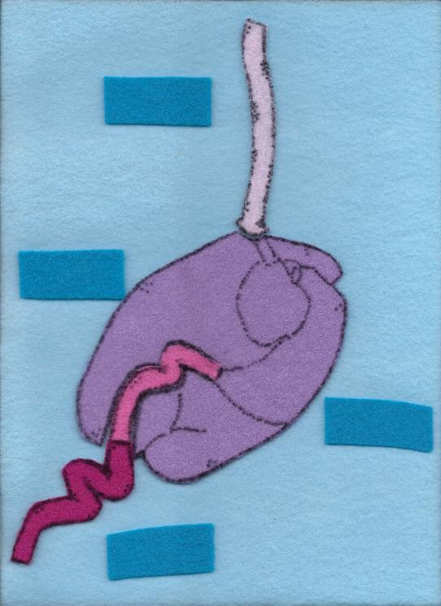
DOMESTIC COW
Esophagus
Stomach
Small intestine
Large intestine

Slide 9
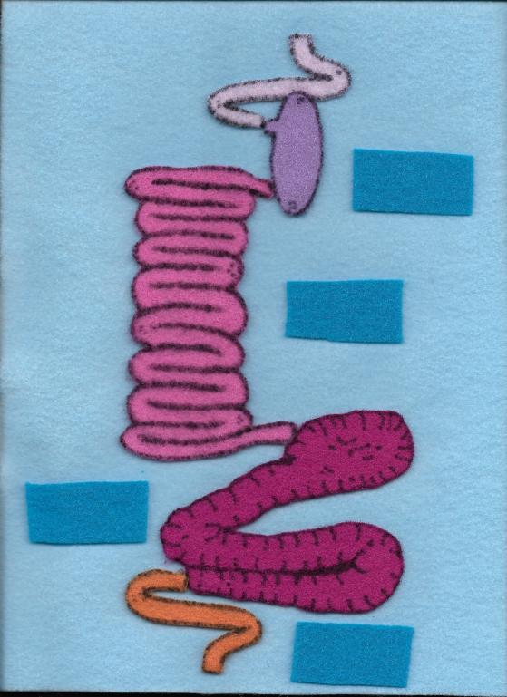
ASIAN ELEPHANT
Esophagus
Stomach
Small intestine
Large intestine
Rectum

Slide 10
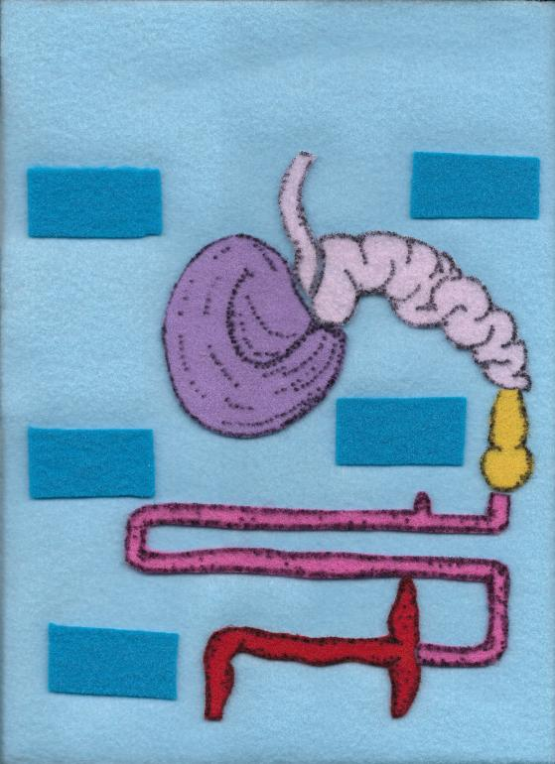
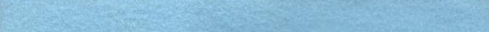
HOATZIN
Crop
Esophagus
Esophagus
Gizzard
Small intestine
Caecum

Slide 11
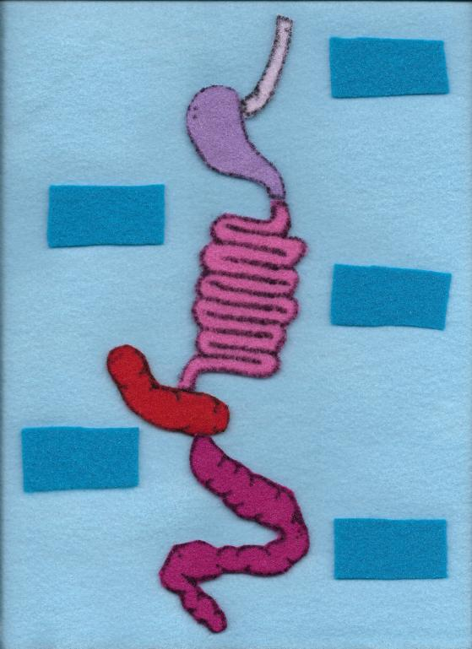
DOMESTIC HORSE
Esophagus
Esophagus
Stomach
Small intestine
Caecum
Large intestine

Slide 12
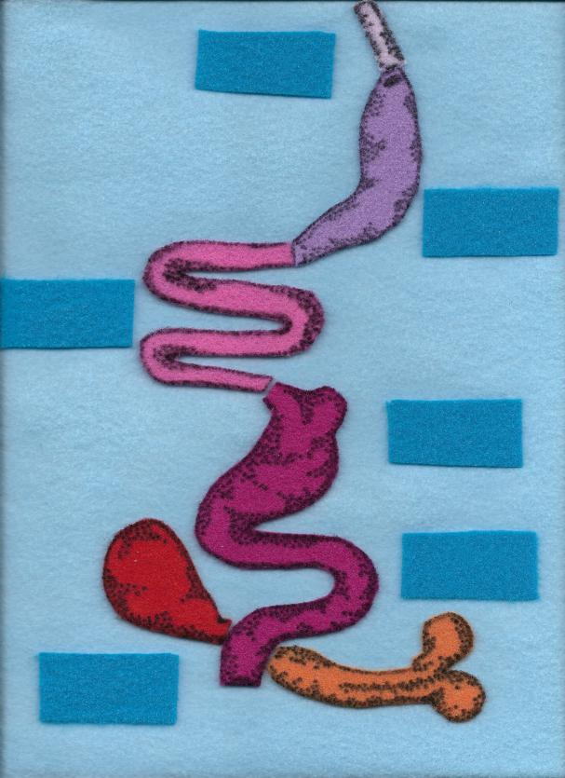
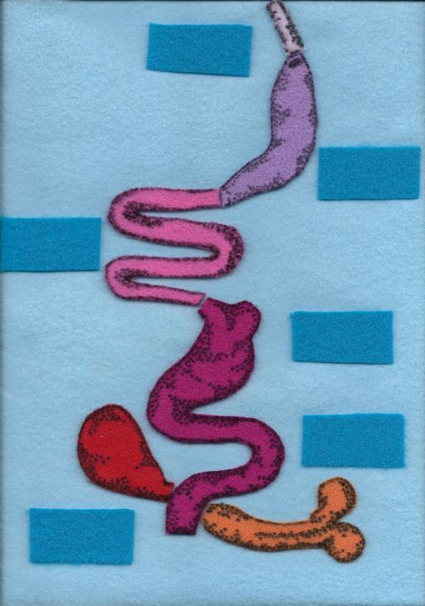
GREEN IGUANA
Esophagus
Esophagus
Stomach
Small intestine
Large intestine
Colon
Caecum

Slide 13
Use the digestive system diagrams and the foregut/hindgut table to fill out the table below.
Animal | Type of Teeth | Which is larger: Foregut or Hindgut? | Is the animal a foregut or hindgut fermenter?
Domestic Cow
Domestic Horse
Asian Elephant
Hoatzin | Gizzard
Green Iguana

Slide 14
Develop Your Hypothesis
Activity 3: Develop Your Hypothesis
Based on all of the previous information, do you think sauropods were foregut or hindgut fermenters?
________________________________________________________
Please provide three sources of evidence, and explain why that evidence supports your hypothesis:
1______________________________________________________________________________________________________________
________________________________________________________
2_______________________________________________________________________________________________________________
________________________________________________________
3_______________________________________________________________________________________________________________
________________________________________________________

Slide 15
Activity 3:
Digestion Model
Notes:
https://pixabay.com/photos/leather-background-structure-orange-2719497/

Slide 16
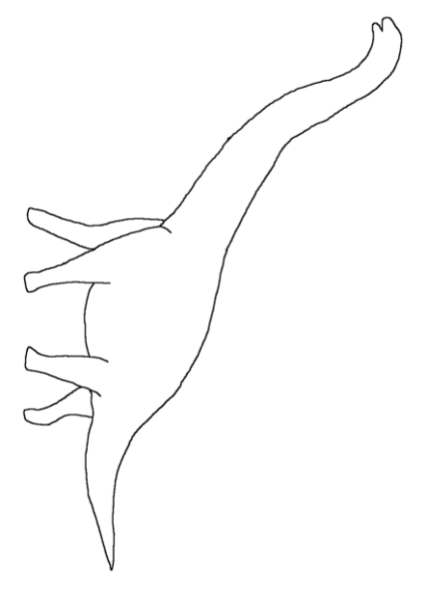
Activity 3: Make a Model
Using your research, cut and paste the organs from the next page that you think belong in a sauropod digestive system into the diagram below

Slide 17





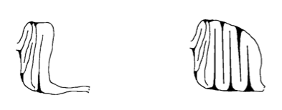

Digestion Structures:
Skull (pick one!)
peg-like teeth
spoon like teeth
2. Esophagus
4. Stomach (pick one!)
Simple Chambered
3. Gastric Mill/Gizzard
(optional)
5. Large and Small Intestines (pick one!)
Short intestines Long intestines
6. Rectum and Anus

Slide 18
List your choices for each part of the digestive system below, and explain your reasoning behind each choice.
1.____________________________________________________________________________________________________________________________________________________________________________________________
2.___________________________________________________________________________________________________________________________________________________________________________________________________________________________________________________________
3.___________________________________________________________________________________________________________________________________________________________________________________________________________________________________________________________
4.____________________________________________________________________________________________________________________________________________________________________________________________________________________________________________________________________________

Slide 19
Activity 4:
Digestion Lab
Notes:
https://pixabay.com/photos/leather-background-structure-orange-2719497/

Slide 20
Activity 4: Lab Instructions
Lab Instructions
Step 1: Prep
● Cover your work surface with garbage bags or a reusable tablecloth
Step 2: Prep
● Into a large plastic bowl, tear your leafy greens into small pieces, about the size of your pointer finger. You’ll need around 20 of these pieces.
Step 3: Teeth
A) Peg-like Teeth:
● Using your spaghetti spoon or pencil, roughly poke holes into your leaves for 2 minutes. At the end of the 2 minutes, the leaves will look a little torn, and dark polka-dot like spots may appear on the leaves.
● Tip: If using a spaghetti spoon, you can push the leaves against the side of your bowl with your spoon to break them down more easily
B) Spoon-like Teeth:
● Using your wooden spoon, roughly chop your leaves for 2 minutes. At the end of the 2 minutes, the leaves will loom a little torn, and dark stripes may appear on the leaves.
Question: What type of digestion is occurring here?

Slide 21
Lab Instructions (pg 2)
Step 4: Gastric Mill (optional)
● Add your greens to a quart-sized plastic bag, and add up to 5 small rocks. Massage the bag in your hands, and use the rocks to grind the greens down further for 1 minute. Remove rocks, and transfer greens to stomach bag.
Question: What type of digestion is occurring here?
Step 5: Stomach
A) Simple Stomach:
● Add greens to sandwich sized bag, and add 4 tbs. white vinegar. Gently massage and shake for 1 minute, careful not to open the bag.
Question: What types of digestion are occurring here?
B) Chambered Stomach:
● Add greens to sandwich sized bag, and add 2 tbs vinegar, 2 tbs. water, and one probiotic capsule. Seal the bag.
● Once the bag is sealed, locate the probiotic capsule in the bag, and gently crush it. Massage and shake for 1 minute, until you can no longer see remnants of the capsule among your leaves.
● Once dissolved, carefully transfer your mixture back to either your large plastic bowl OR your gastric mill, if you chose to use it.
● If you used a gastric mill, repeat steps 4 and 5 twice. If you did not use a gastric mill, repeat steps 3 and 5 twice. Each time step 5 occurs, add only 1 tbs vinegar and one probiotic tablet.

Slide 22
Lab Instructions (pg 3)
Step 5 (con’t)
● After completing this cycle 2 times, funnel your mixture into a jar and seal it loosely. Write your name on your jar, today’s date, and put the jar in a place where it can be easily accessed and observed. Clean up your station, and let jar rest at least overnight – preferably for 24 hours – before continuing to step 6.
Question: What sort of fermentation are you creating in your jar – hindgut or foregut?
Step 6: Small & Large Intestine
A) Short Intestines:
● Add ½ tbs. of baking soda to your leaf mixture. This acts like bile in a normal digestive system, to neutralize the stomach acid. Be sure to leave a small opening in the mouth of your container, to allow gases to escape.
● Over a bowl, transfer liquid from stomach into the opening of a pair of pantyhose. Over a bowl, squeeze the leaf mixture down the stocking, squeezing water out until the leaf material is dry and compacted in the toe.
B) Long Intestines:
● Over a bowl, add ½ tbs of baking soda to your leaf mixture. This acts like bile in a normal digestive system, to neutralize the stomach acid. Be sure to leave a small opening in the mouth of your container, to allow gases to escape.

Slide 23
Lab Instructions (pg 4)
Step 6 (con’t)
● Funnel your mixture into a jar and seal it loosely. Write your name on your jar, today’s date, and put the jar in a place where it can be easily accessed and observed. Clean up your station, and let jar rest – preferably for 48 hours – before continuing.
Question: What sort of fermentation are you creating in your jar – hindgut or foregut?
● Stretch the opening of one pair of pantyhose over the mouth of your jar. Over a bowl, empty contents of jar into the attached pantyhose. Squeeze the leaf mixture down the stocking, squeezing water out until the leaf material is dry and compacted in the toe.
Step 7: Rectum & Anus
● Once all water is squeezed from leaf material, roll the mouth of your stocking down toward the compacted leaves at the bottom of the toe – and deposit your finished “sauropod feces” in a sandwich bag.
Congratulations! You made sauropod poop!
After completing the lab, think about the process you went through.
How closely do you think you replicated a sauropod digestive tract?
Knowing what you know now, what changes would you make if you were to try this activity again?

Slide 24
Notes

Slide 25
Notes

Slide 26
Notes

Slide 27
Notes

Slide 28
Notes

